Slide 1
IMPACT OF COVID 19 IN U.S.A. CAPSTONE PROJECT BY ROHAN DESAI AND VIDHI KAMLESH SHAH – M.I.T.A. – RUTGERS UNIVERSITY MENTORED BY – Dr. SERGEI SCHREIDER

Slide 2
COVID – 19
Coronavirus disease 2019 (COVID-19) is a contagious disease caused by severe acute respiratory syndrome coronavirus 2 (SARS-CoV-2). The first case was identified in Wuhan, China in December 2019.
Common symptoms of COVID-19 include fever, cough, fatigue, breathing difficulties, and loss of smell and taste. Symptoms begin one to fourteen days after exposure to the virus. While most people have mild symptoms, some people develop acute respiratory distress syndrome (ARDS).
COVID-19 spreads from person to person mainly through the respiratory route after an infected person coughs, sneezes, sings, talks or breathes.

Slide 3
COVID – 19: World cases
Active Cases
64.4M
(Approximate population of France)
Recovered Cases
41.3M
(Approximate population of Ukraine)
Death Cases
1.49M
(Approximate population of Bahrain)

Slide 4
Project Scope: To Track real-time COVID-19 cases in U.S.A. from Data provided by Johns Hopkins University. Then Perform Analysis on Data and future Predictions of Death Cases in real time.
Data Repository
Link

Slide 5
Technologies used in Project
Database : MongoDb (Cloud)
Programming Language: Python (PyCharm IDE)
Visualization : MongoDB Atlas (Cloud)
Models: Holts Winter Model and ARIMA

Slide 6
Project Approach
Web Scrap Data from Johns Hopkins University’s Data repository using Python.
Process and Clean the Data and insert it into MongoDB cloud after establishing connection.
Generate real time Visualizations from MongoDB data on MongoDB Atlas charts

Slide 7
Project Approach
Pull the Data in Python for Forecasting
Clean the Data for prediction
Perform Prediction

Slide 8
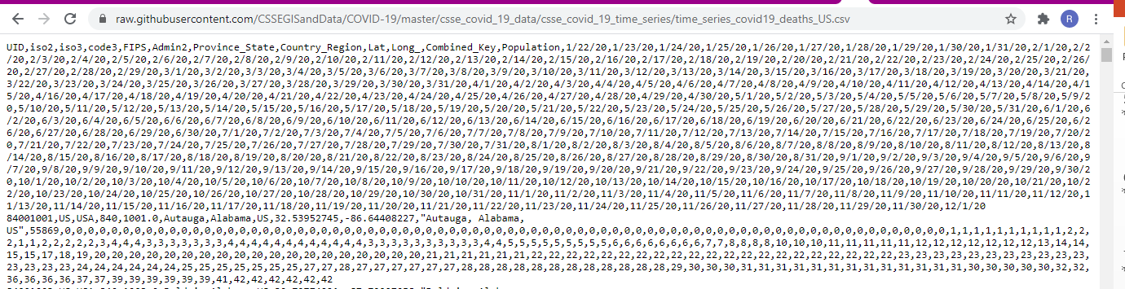
Web Scrapping

Slide 9
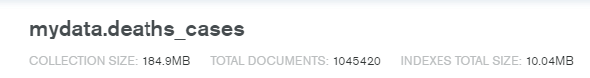
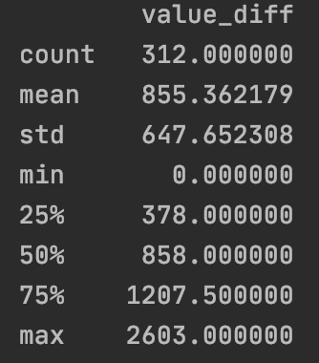
Data Analysis
Death Cases collection in MongoDb has total documents 1045420. (data segregated county wise)

Slide 10
Data Visualization
Let graphics represent Data

Slide 11
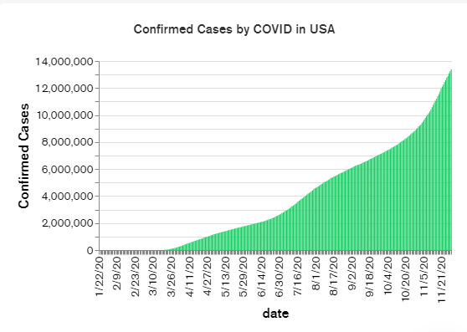
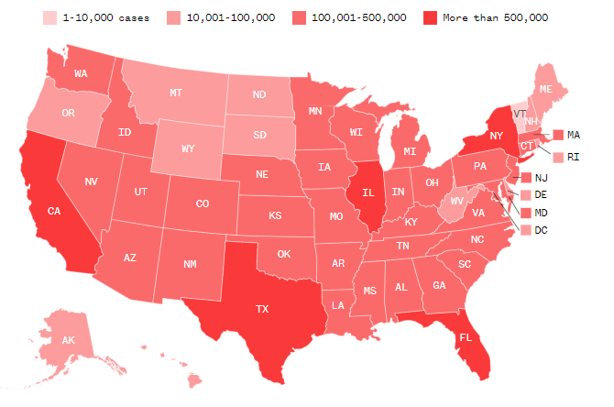
Confirmed Cases in U.S.A

Slide 12
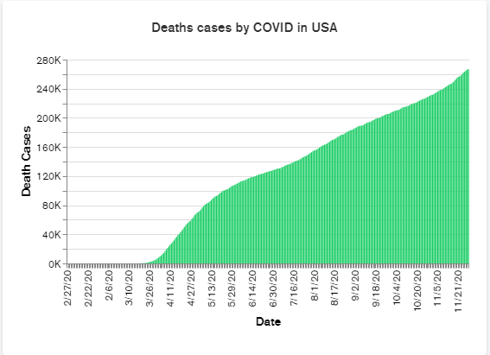
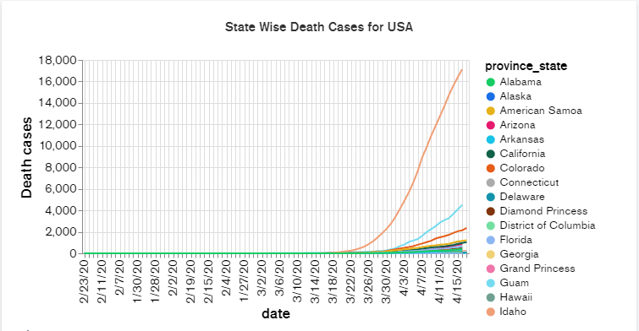
Death Cases Total Death Cases in USA vs State wise Drill down

Slide 13
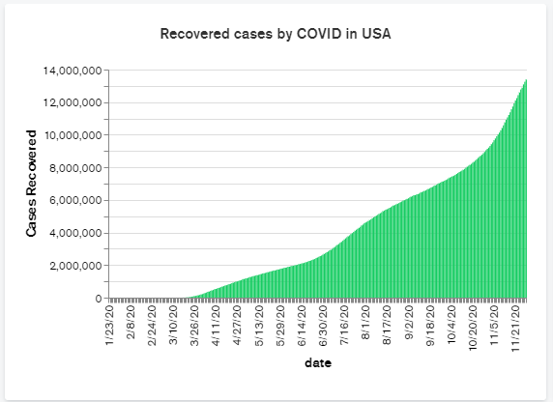
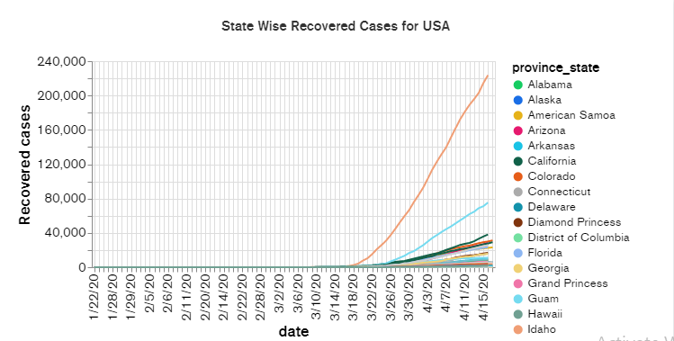
Recovered Cases Total Recovered Cases in USA vs State wise Drill down

Slide 14
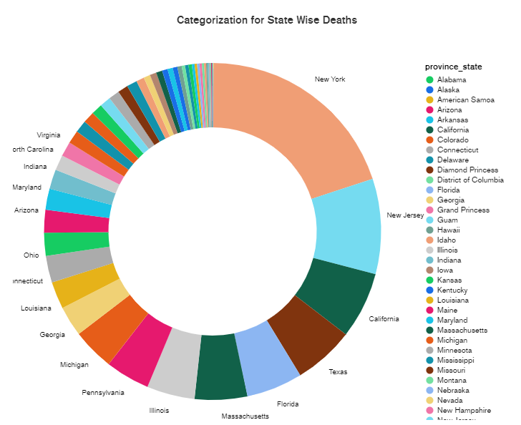
Death Cases State wise – Pie chart
This Pie chart provides a graphical view of Death cases in states in U.S.A.
We can see that state of N.Y. has maximum number of deaths.

Slide 15
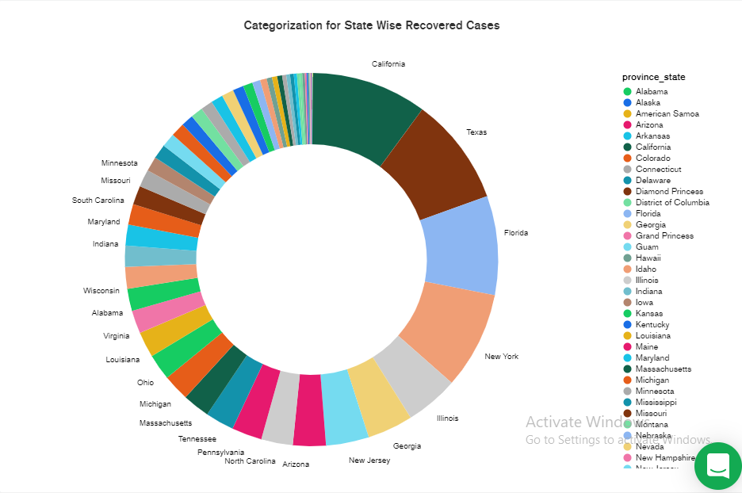
Recovered Cases State wise – Pie chart
This Pie chart provides a graphical view of Recovered cases in U.S.A. state wise
We can see that state of California has maximum number of recoveries.

Slide 16
Data Prediction
Now in this step we pull data from collection in MongoDB into Python and store it in Dataframe
We remove null values if any.
Then we check if Data is stationary or not.

Slide 17
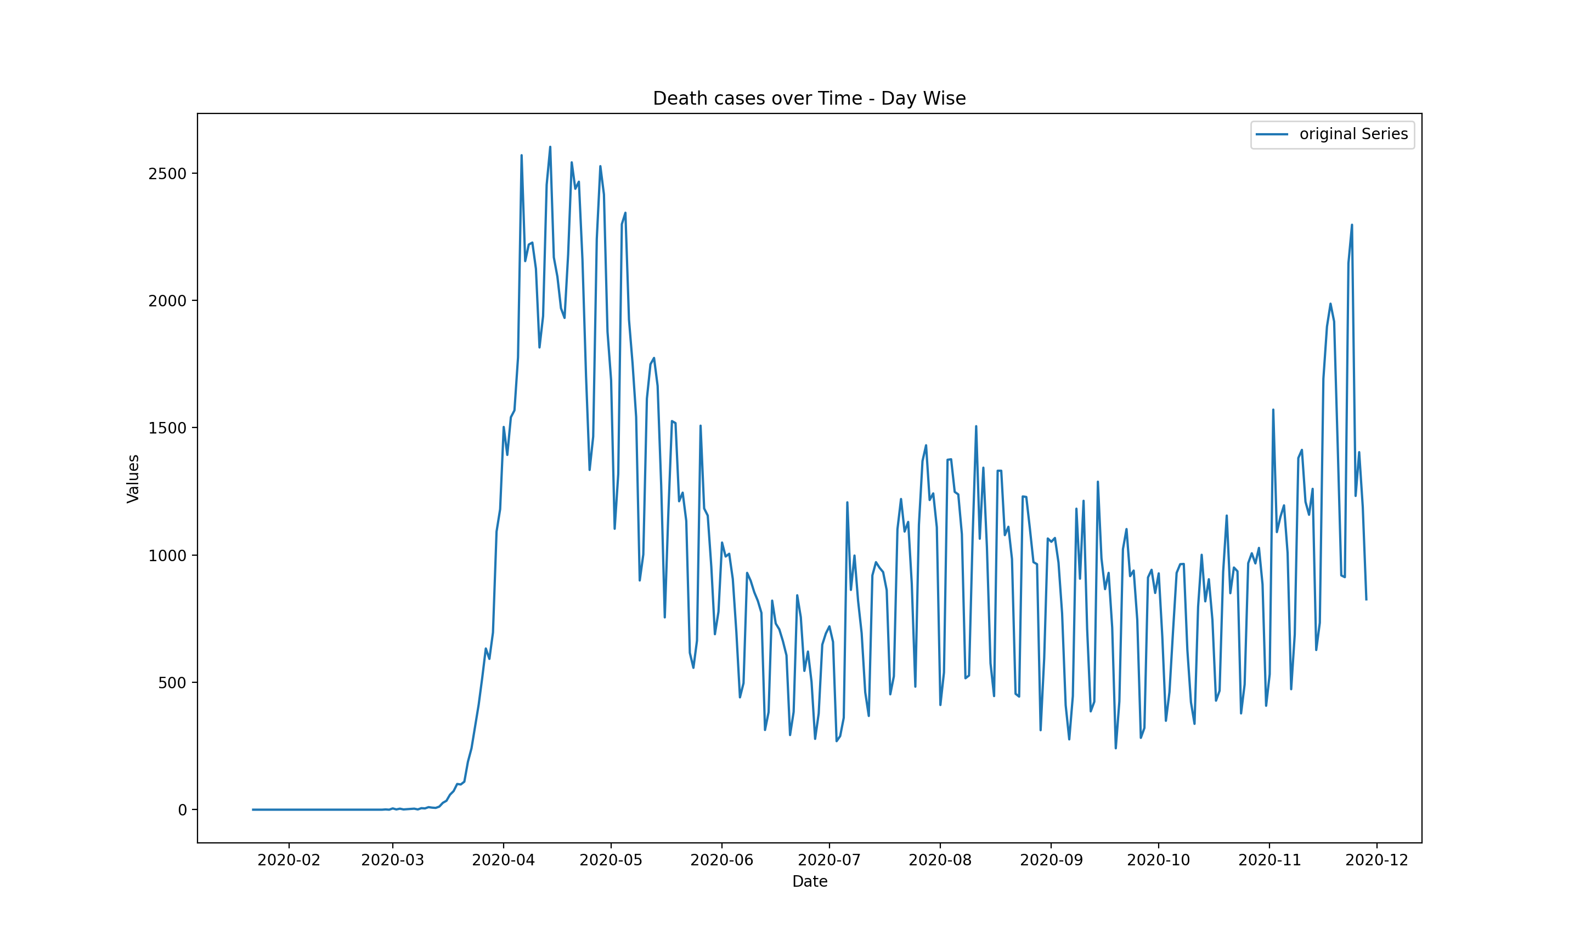
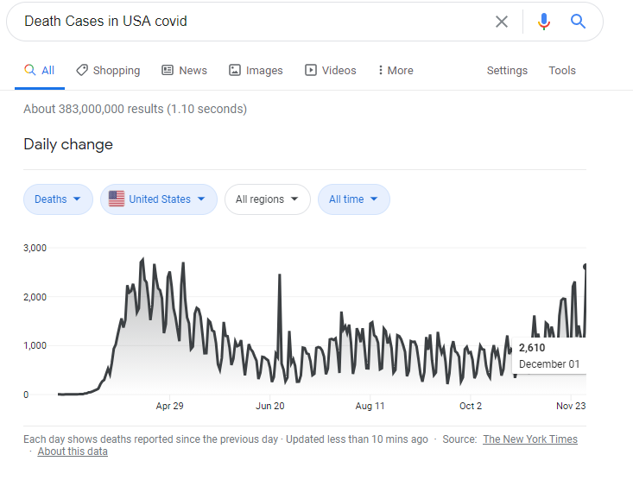
Plotting Death cases Web Scrapped data vs Google Data

Slide 18
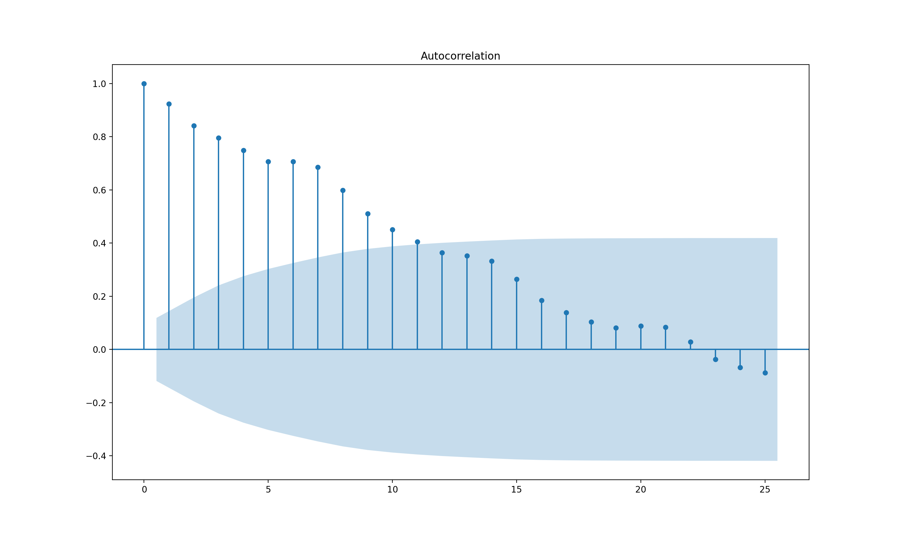
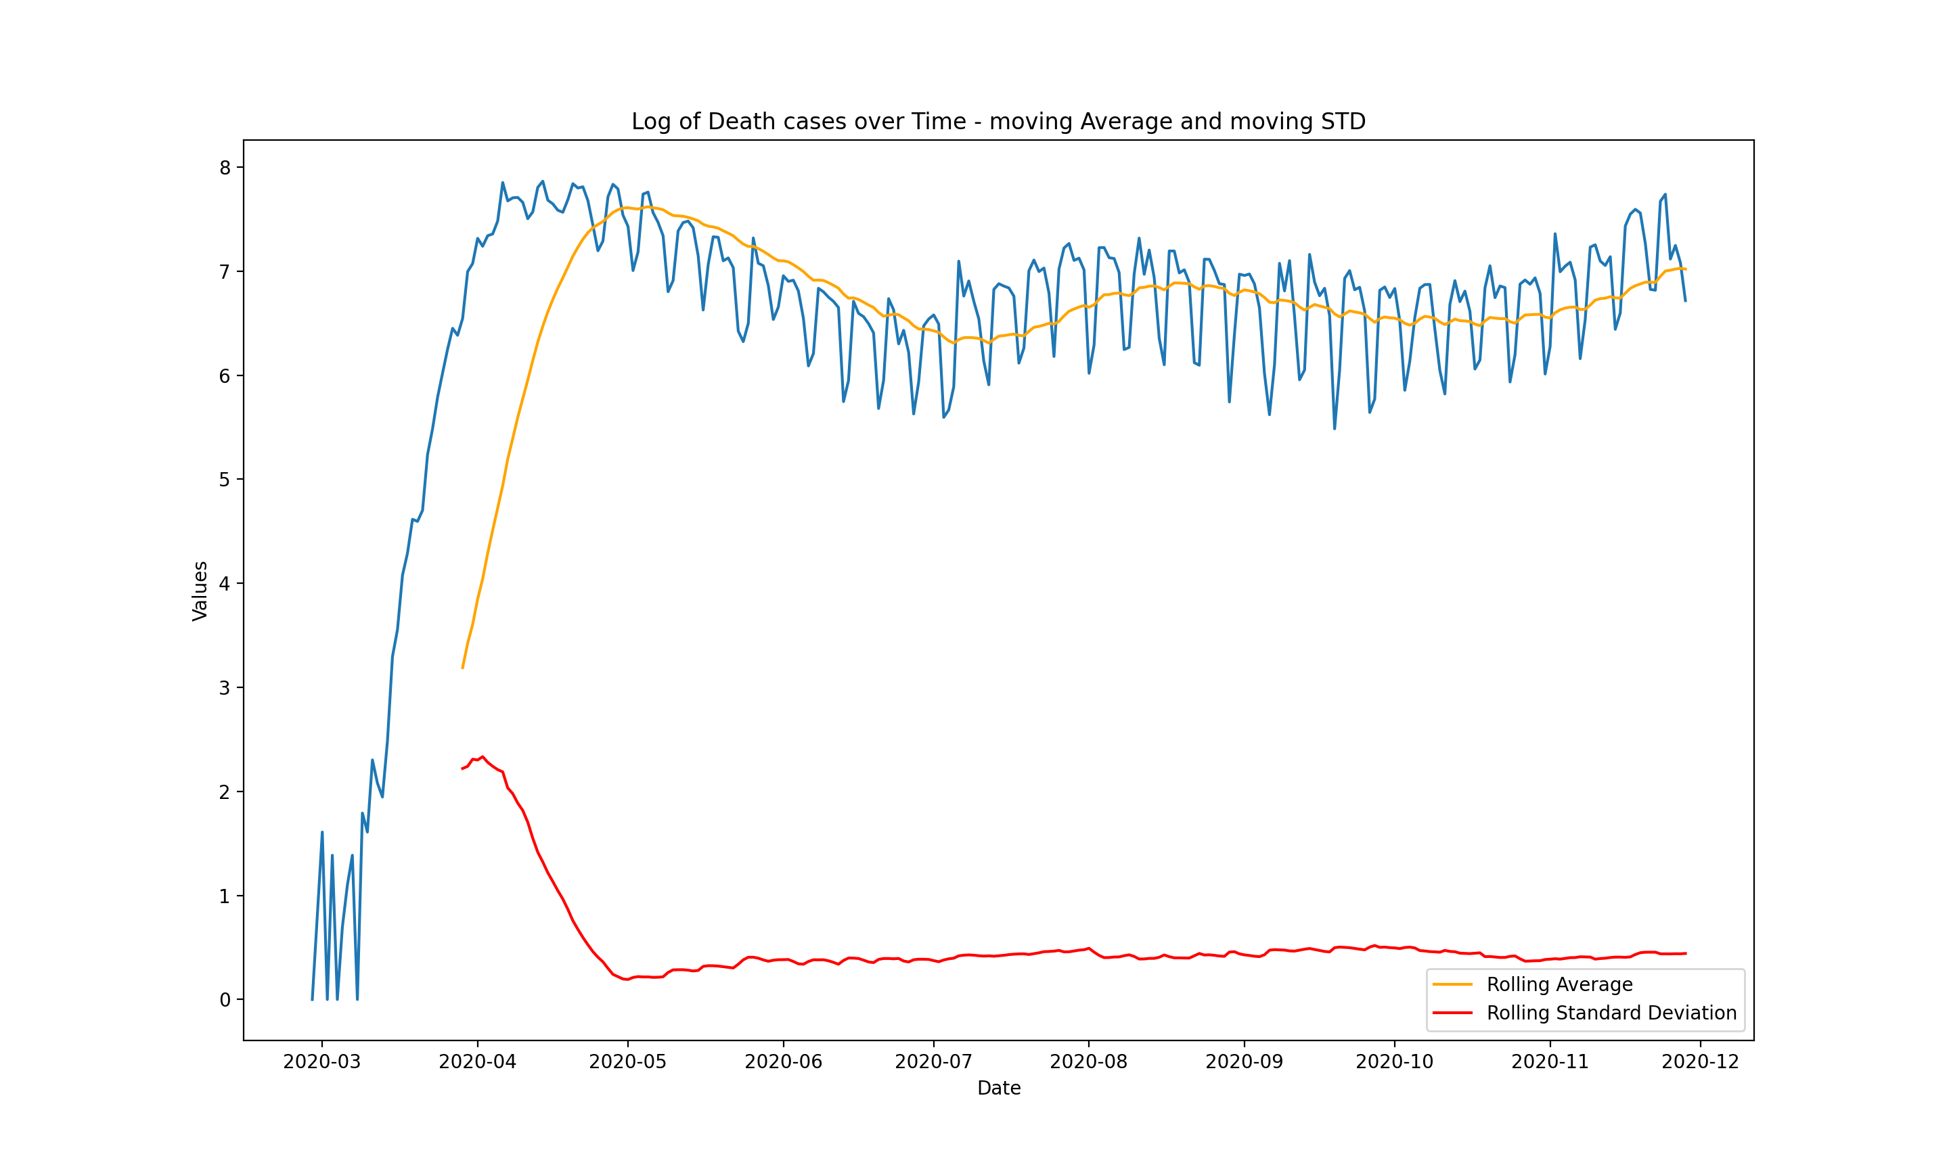
Make time series Stationary
A stationary time series is one whose statistical properties such as mean, variance, autocorrelation, etc. are all constant over time. Most statistical forecasting methods are based on the assumption that the time series can be rendered approximately stationary (i.e., "stationarized") through the use of mathematical transformations.

Slide 19
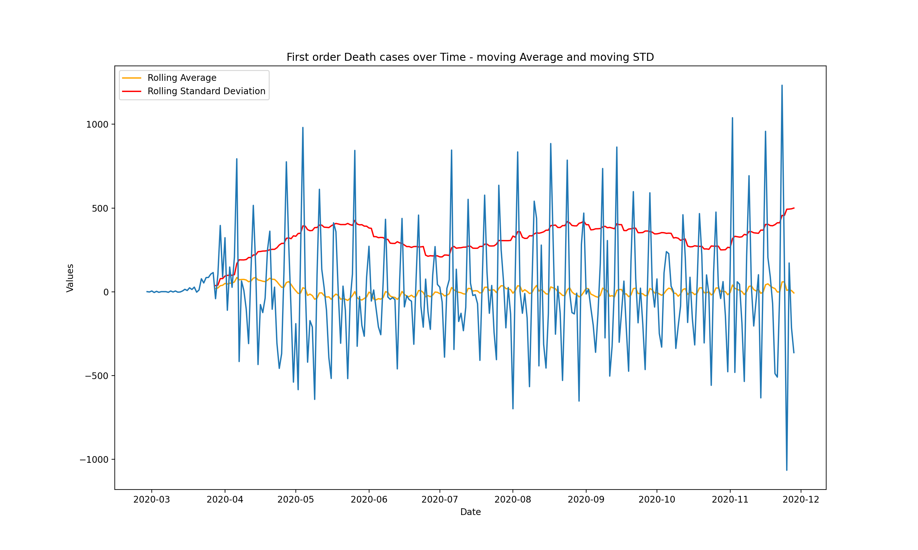
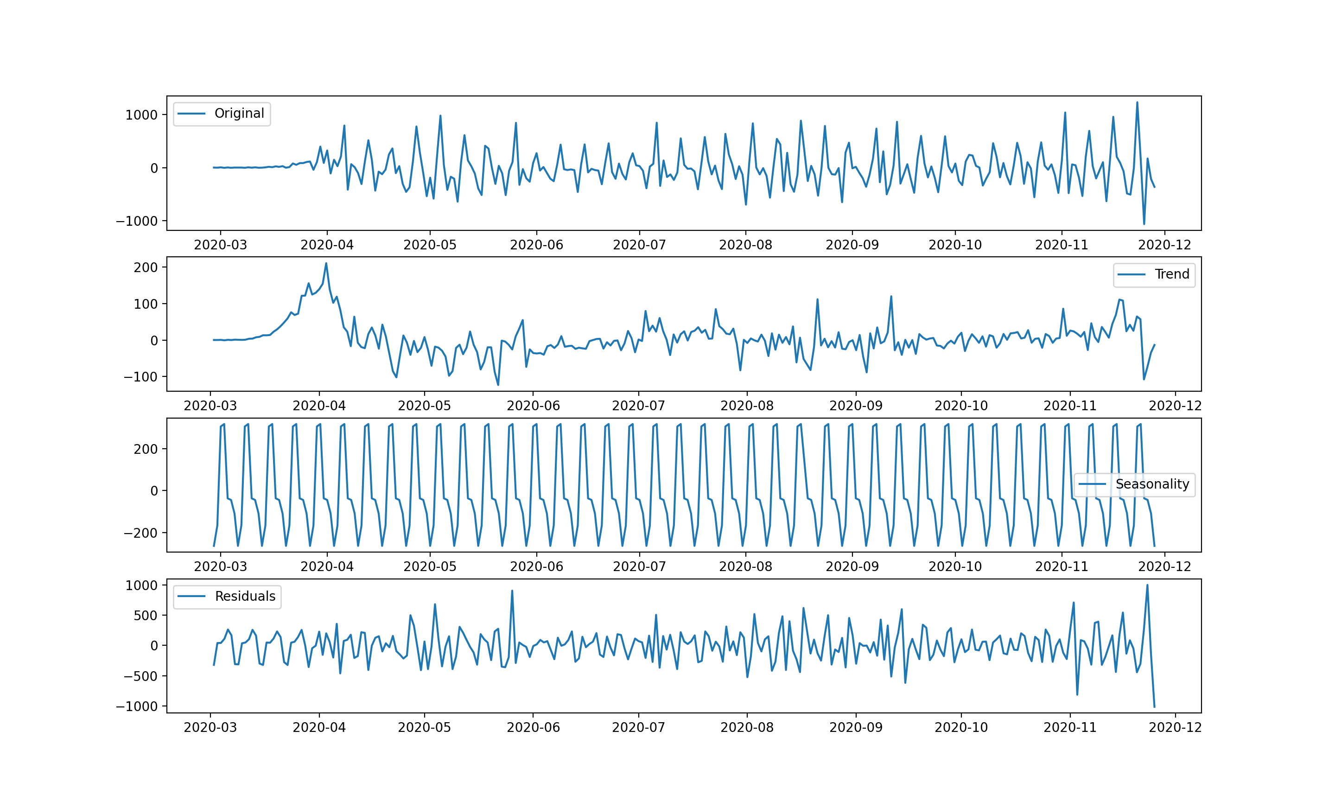
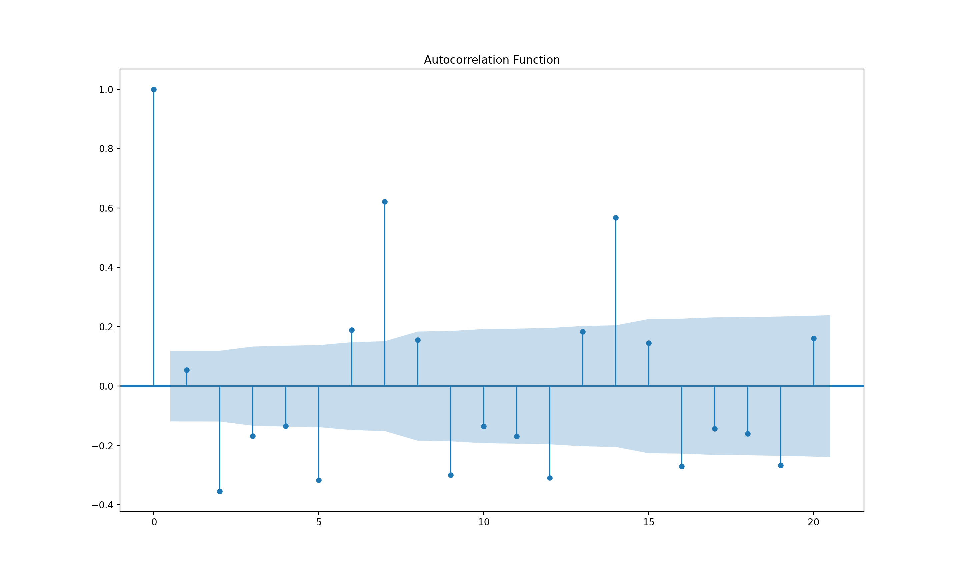
First order Differencing
STL Decomposition
ACF

Slide 20
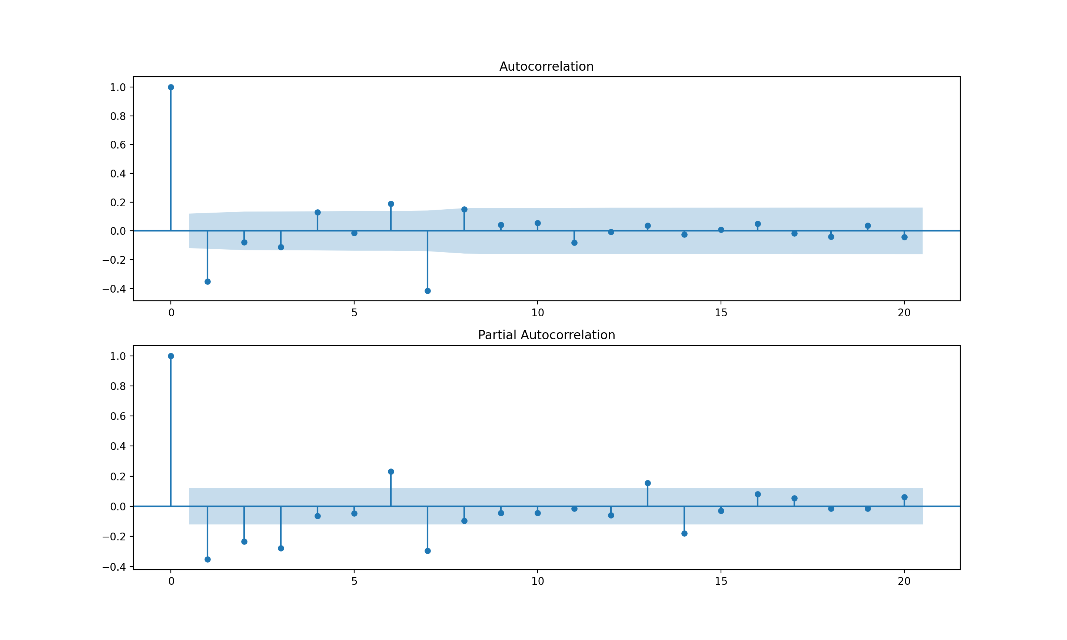
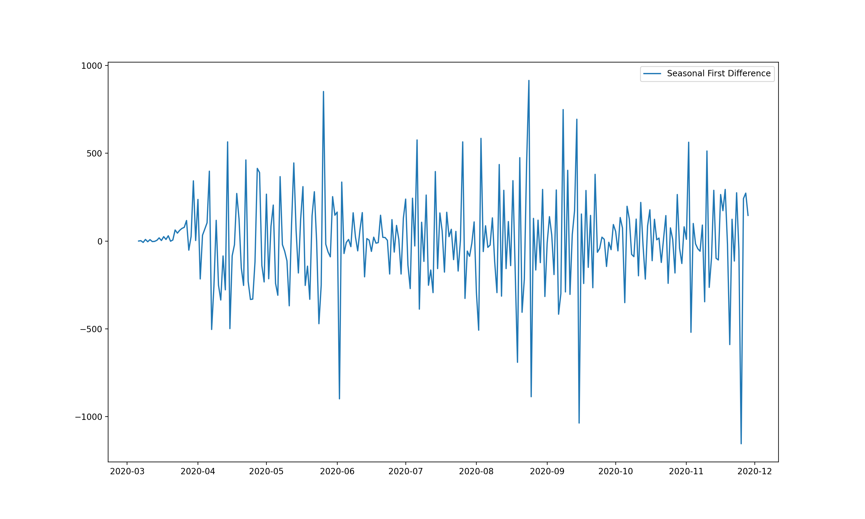
Remove Seasonality
ACF and PACF after removing seasonality
First order seasonal Differencing

Slide 21
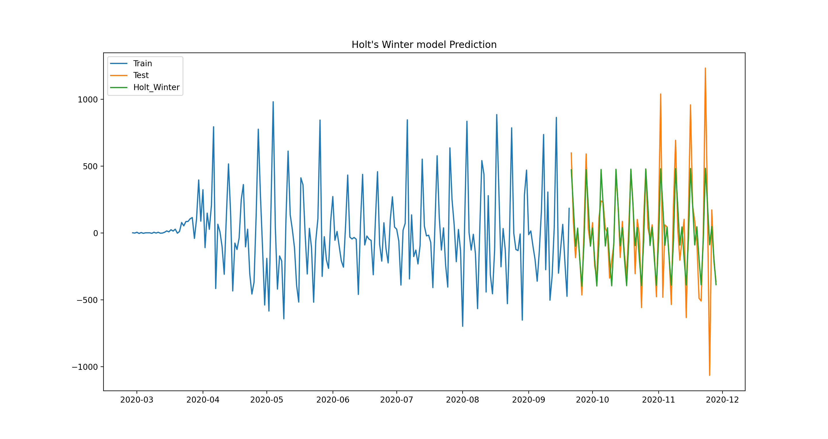
Holt Winter’s model for Prediction of Death Cases
Test data: 25%
Train Data:75%
rmse: 311.22

Slide 22
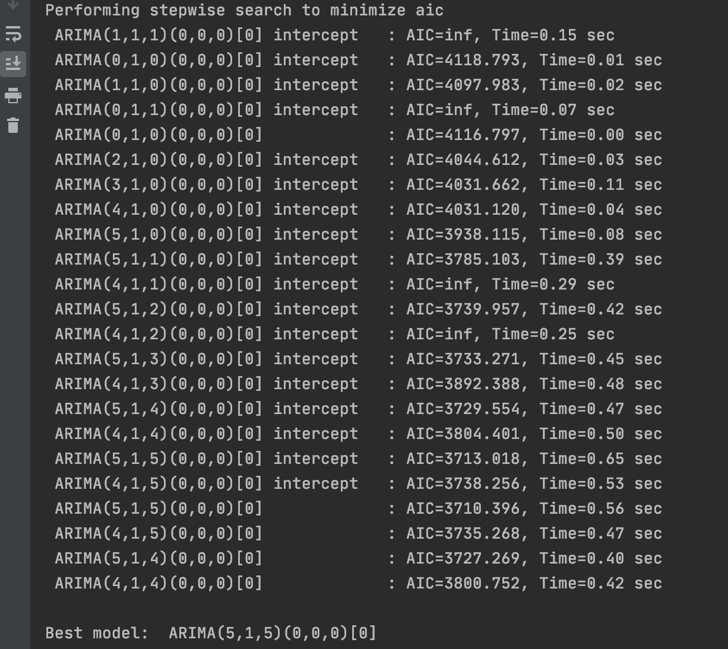
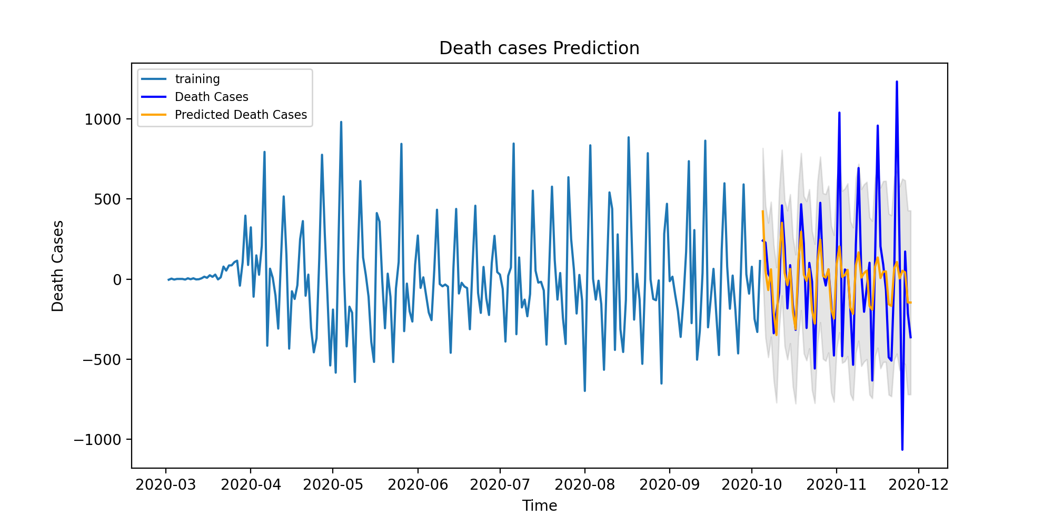
ARIMA model for Prediction of Death Cases [arima (5,1,5)]
AIC : 3710
RMSE: 415
MAE: 275

Slide 23

Conclusion
For our Time Series – Holt’s Winter model fitted perfectly than ARIMA model. To predict COVID -19 accurately we need to perform Hybrid modelling which will increase accuracy of Data Model.
How to stay Safe?
Thank you

